Slide 1
Decision Tree

Slide 2
Classification
Decision Tree Induction is the learning of decision trees from class-labeled training tuples.
Decision tree is a flowchart like tree structure, where each internal node denotes the test on an attribute, each branch represents an outcome of the test, and each leaf node bolds a class label.

Slide 3
How are decision tree used from classification?
Why are decision tree classifiers so popular? (appropriate for exploratory knowledge discovery)
DT can handle high dimensional data and has good classification accuracy.

Slide 4
Classification
Classification by Decision Tree Induction
ID3 (Iterative Dichotomiser)
C4.5
CART (Classification & Regression Tree)
ID3, C4.5 and CART adopt a greedy approach in which decision tree are constructed in a top-down recursive divide-and-conquer manner.

Slide 5
Classification
Classification by Decision Tree Induction

Slide 6
The recursive partitioning stops only when one of the following terminating condition is true:
All the tuples in partition D belong to the same class
There are no remaining attributes on which the tuples may be further partitioned. In this case majority voting is employed.
There are no tuples for a given branch, that is, a partition D_{j}, is empty. In this case, a leaf is created with the majority class in D.

Slide 7
Attribute Selection Procedure
It is a heuristic for selecting the splitting criterion that “best” separates a given data partition, D, of class-labelled training tuples into individual classes.
It is also known as splitting rules because they determine how the tuples at a given node are to be split.
It provides ranking for each attribute describing the given training tuple. The attribute having the best score for the measure is chosen as the splitting attribute for the given tuples.
Well known attribute selection measures are : information gain, gain ratio, gini index.

Slide 8
Choose an attribute to partition data
The key to building a decision tree – which attribute to choose in order to branch.
The objective is to reduce impurity or uncertainty in data as much as possible (A subset of data is pure if all instances belong to the same class).
The heuristic : is to choose the attribute with the maximum information gain or Gain Ratio based on information theory.

Slide 9
Information Theory
Information Theory provides a mathematical basis for measuring the information content.
To understand the notion of information, think about it as providing the answer to a question, for example whether a coin will come up heads.
If one already has a good guess about the answer, then the actual answer is less informative.
If one already knows that the coin is rigged so that it will come with heads with probability 0.99, then a message (advanced information) about the actual outcome of a flip is worth less than it would be for a honest coin (50 - 50).
For a fair (honest) coin, you have no information, and as much less you know, the more valuable the information is.

Slide 10
information theory uses this same intuition, by measuring the value for information contents in bits.
one bit of information is enough to answer a yes/no question about which one has no idea, such as the flip of a fair coin.
Entropy (Information) measure :
Where p_{i} be the probability that an arbitrary tuple in D belongs to class C_{i}, estimated by |C_{i}, D|/|D|
We use entropy ( information) as a measure of impurity of data set D.

Slide 12
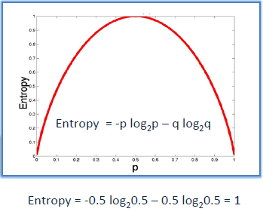
http://www.saedsayad.com/decision_tree.htm
As the data becomes purer and purer, the entropy value becomes smaller and smaller.
Constructing a tree is all about finding attributes that returns the highest information Gain (i.e. the most homogeneous branches.

Slide 13
Classification
Classification by Decision Tree Induction – ID3
Let node N hold the tuples of partition D.
The attribute with the highest information gain is chosen as the splitting attribute for node N.
This attribute minimizes the information needed to classify the tuples in the resulting partitions and reflects the least randomness or “impurity” in these partitions.
Such an approach minimizes the expected number of tests needed to classify a given tuple and guarantees that a simple (but not necessarily the simplest) tree is found.
The expected information needed to classify a tuple in D is given by

Slide 14
Classification
Classification by Decision Tree Induction – ID3
Where p_{i} is the probability that an arbitrary tuple in D belongs to class C_{i} and is estimated by |C_{i,D}|/|D|.
A log function to the base 2 is used, because the information is encoded in bits.
Info(D) is just the average amount of information needed to identify the class label of a tuple in D.
Note that, at this point, the information we have is based solely on the proportions of tuples of each class.
Info(D) is also known as the entropy of D.

Slide 15
Classification
Classification by Decision Tree Induction – ID3
Now, suppose we were to partition the tuples in D on some attribute A having v distinct values, {a₁, a₂, …, a_{v}}, as observed from the training data.
If A is discrete-valued, these values correspond directly to the v outcomes of a test on A.
Attribute A can be used to split D into v partitions or subsets, {D₁, D₂, …, D_{v}}, where D_{j} contains those tuples in D that have outcome a_{j} of A.
These partitions would correspond to the branches grown from node N. Ideally, we would like this partitioning to produce an exact classification of the tuples.

Slide 16
Classification
Classification by Decision Tree Induction – ID3
That is, we would like for each partition to be pure.
However, it is quite likely that the partitions will be impure (e.g., where a partition may contain a collection of tuples from different classes rather than from a single class).
How much more information would we still need (after the partitioning) in order to arrive at an exact classification?
This amount is measured by
The term |D_{j}|/|D| acts as the weight of the j^{th} partition. Info_{A}(D) is the expected information required to classify a tuple from D based on the partitioning by A.
The smaller the expected information (still) required, the greater the purity of the partitions.

Slide 17
Classification
Classification by Decision Tree Induction – ID3
Information gain is defined as the difference between the original information requirement (i.e., based on just the proportion of classes) and the new requirement (i.e., obtained after partitioning on A).
That is, Gain(A) = Info(D) - Info_{A}(D)
In other words, Gain(A) tells us how much would be gained by branching on A.
It is the expected reduction in the information requirement caused by knowing the value of A.
The attribute A with the highest information gain, (Gain(A)), is chosen as the splitting attribute at node N.
This is equivalent to saying that we want to partition on the attribute A that would do the “best classification,” so that the amount of information still required to finish classifying the tuples is minimal (i.e., minimum Info_{A}(D)).

Slide 18
Classification
Classification by Decision Tree Induction – ID3
BUYS
YES | NO
9 | 5
Age
Youth | Middle Age | Senior
5 | 4 | 5

Slide 19
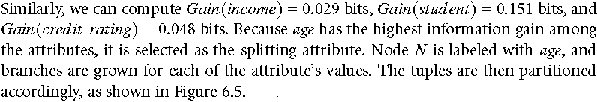
Classification
Classification by Decision Tree Induction – ID3
Age
Youth | Middle Age | Senior
5 | 4 | 5
2 (yes), 3(no) | 4 (yes) 0(no) | 3 (yes),2(no)

Slide 20
Classification
Classification by Decision Tree Induction – ID3

Slide 21
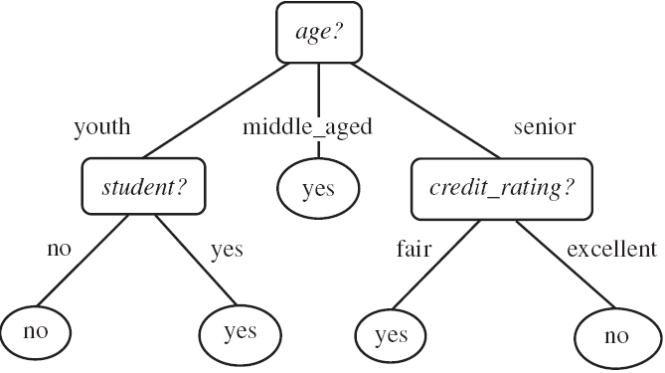

Slide 22
Classification
Classification by Decision Tree Induction – C4.5
Gain Ratio
The information gain measure is biased toward tests with many outcomes.
That is, it prefers to select attributes having a large number of values.
For example, consider an attribute that acts as a unique identifier, such as product ID.
A split on product ID would result in a large number of partitions (as many as there are values), each one containing just one tuple.
Because each partition is pure, the information required to classify data set D based on this partitioning would be Info_{product_ID}(D) = 0.
Therefore, the information gained by partitioning on this attribute is maximal.
Clearly, such a partitioning is useless for classification. C4.5, a successor of ID3, uses an extension to information gain known as gain ratio, which attempts to overcome this bias.

Slide 23
Classification
Classification by Decision Tree Induction – C4.5
Gain Ratio
It applies a kind of normalization to information gain using a “split information” value defined analogously with Info(D) as
The attribute with the maximum gain ratio is selected as the splitting attribute.

Slide 24
Classification
Classification by Decision Tree Induction – C4.5
Gain Ratio

Slide 25
Classification
Classification by Decision Tree Induction – CART
Gini Index
The Gini index measures the impurity of D, a data partition or set of training tuples, as
The Gini index considers a binary split for each attribute.
For discrete-valued attribute, all possible combinations of its value except empty set and power set are considered for binary split.
For a discrete-valued attribute, the subset that gives the minimum gini index for that attribute is selected as its splitting subset.
For continuous-valued attributes, each possible split point must be considered.

Slide 26
Classification
Classification by Decision Tree Induction – CART
Gini Index
The reduction in impurity that would be incurred by a binary split on a discrete- or continuous-valued attribute A is
The attribute that maximizes the reduction in impurity (or, equivalently, has the minimum Gini index) is selected as the splitting attribute.

Slide 27
Classification
Classification by Decision Tree Induction – CART
Gini Index

Slide 28
Classification
Classification by Decision Tree Induction
Information gain, as we saw, is biased toward multivalued attributes.
Although the gain ratio adjusts for this bias, it tends to prefer unbalanced splits in which one partition is much smaller than the others.
The Gini index is biased toward multivalued attributes and has difficulty when the number of classes is large.
It also tends to favour tests that result in equal-sized partitions and purity in both partitions.
Although biased, these measures give reasonably good results in practice.

Slide 29
Disclaimer
Content of this presentation is not original and it has been prepared from various sources for teaching purpose.

